Slide 1
CSET301 – AI-ML
Lecture 5 : Regularized Linear Regression

Slide 2
Outline
Model fitting
Overfitting
Regularization
L1, L2, Elastic Net regularization
Bias
Variance

Slide 3
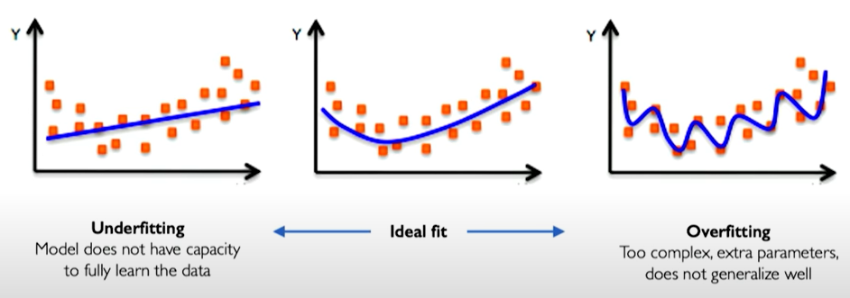
Model Fitting, Overfitting, Underfitting
Objective of model fitting: We want ML models to learn a representation of our data that can generalize to new data.
Overfitting: Overfitting happens when a ML model learns not only the underlying patterns in the training data but also noise and random fluctuations, making it perform very well on training data but poorly on new, unseen data.

Slide 4
Overfitting
Problem of overfitting
Defined as the inability of the model to generalize.
Analogy: This is the same as memorizing the answers to a Maths quiz instead of knowing the formulas. Because of this, the model cannot generalize. Everything is all good as long as you are in familiar territory, but as soon as you step outside, you’re lost.

Slide 5
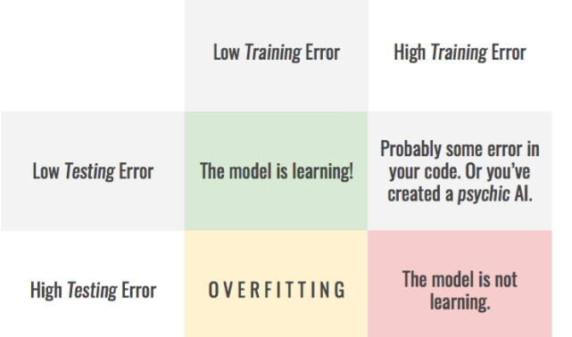
Overfitting

Slide 6
Overfitting
Under what scenarios overfitting happens:
1. Model Too Complex: Using models with too many parameters, like very deep neural networks, high-degree polynomial regression, etc. The model learns every minor detail (including noise) from the training data.
2. Too Few Training Samples: When you have a small dataset, the model can memorize all the training examples rather than generalizing from them. This is common in domains like medical imaging or genomics where data is hard to collect.
3. Too Many Features (High Dimensionality): More features can give the model more room to "cheat" by finding irrelevant patterns. This is also known as the curse of dimensionality.

Slide 7
Overfitting
Ways to mitigate overfitting:
Gather more data: As we add more data, the model becomes unable to overfit all the training samples and is forced to generalize to make progress.
Regularization: Reduce model complexity by constraining the optimization problem
Data augmentation & Noise: Data collection is a tedious and expensive process. If it is not possible, we should try to make your data appear as if it was more diverse. For that, data augmentation techniques can be used.

Slide 8
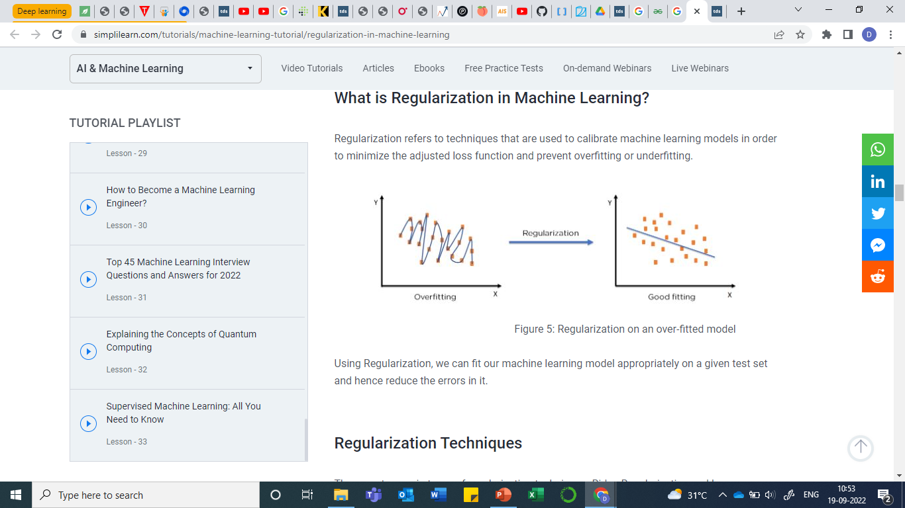


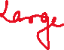











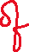

Regularization

Slide 9
Regularization
One of the techniques used to overcome the problem of overfitting
Introduced in training to constrain our optimization problem to discourage complex models
Improve generalization of our model on unseen data
In regularization, we want to allow some error on training data

Slide 10
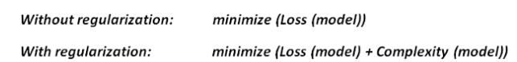
Regularization
Regularization controls the model complexity by penalizing higher terms in the model. If a regularization term is added, the model tries to minimize both loss and complexity of model.

Slide 11
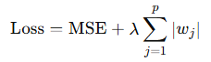
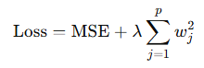
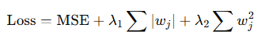
Regularization techniques
Lasso Regularization (L1 Regularization): penalizes absolute weights
Ridge regularization (L2): penalizes large weights, but do not make them exactly zero.
Elastic Net (combination of L1 and L2): Balances between Ridge and Lasso

Slide 12













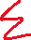
L1 Regularization
Least Absolute Shrinkage and Selection Operator Regression (Lasso) regularization
Penalizes absolute weights.
Makes few weights which are near zero to be zero and allow few weights to remain high.
Thus, tends to eliminate the weights of the least important features (i.e., by setting them to zero).

Slide 13

L2 Regularization
L2 regularization (Ridge Regularization): Penalizes squared weights. Make weights small.

Slide 14
Regularization parameter λ
λ : Hyperparameter. Denotes amount of shrinkage.
If λ = 0 , regularized loss will become original loss. All features are considered.
If λ = ∞ , weights will become zero. Because only at zero weights, the loss will be minimum, else it will be infinity. No feature is considered.
If 0 < λ < ∞ : Positive λ will cause the magnitude of the weights to be smaller than in the usual linear solution. As we increase the λ, weights will shrink more

Slide 15
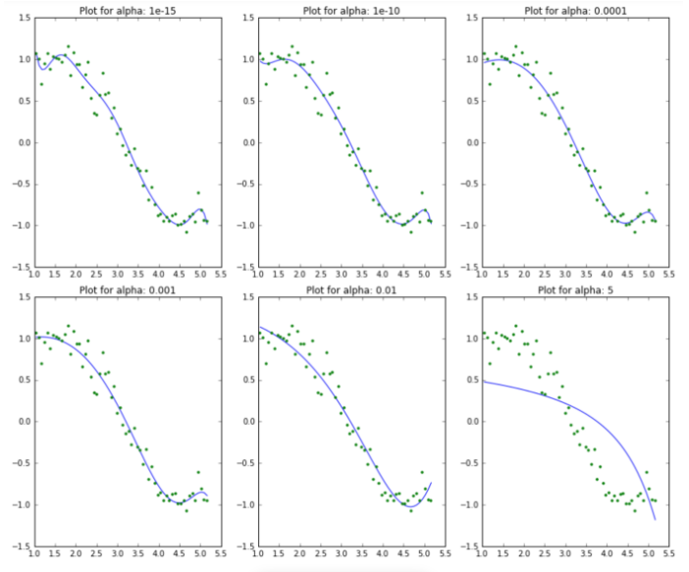
Regularization
As the value of λ increases, the model complexity reduces.
Higher the λ, bigger the penalty.
Though higher values of λ reduce overfitting, significantly high values can cause underfitting as well (eg. λ= 5)

Slide 16

L1 and L2 Regularization
The L1 penalty enforces feature selection
Has a tendency to set to 0 the less useful parameters.
This helps identify the most relevant features in a dataset.
Often not as computationally efficient as the L2 penalty.
L1 matrix is sparse with many zeros, and the L2 matrix has slightly smaller weights.
L2 penalty enforces weights shrinkage.

Slide 17
L1 and L2 Regularization
L1 penalty enforces feature selection
L2 penalty enforces weight shrinkage

Slide 18
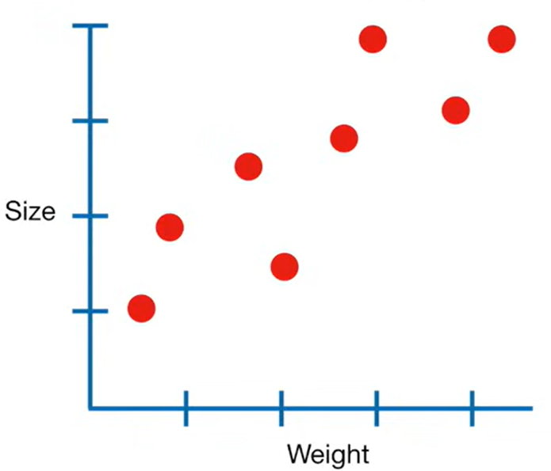
L2 Regularization: Example
Lets say we have measurements of Weights and Size.
Since the data looks linear, we will use Linear Regression or Least Square method to model the relationship between Weight and Size

Slide 19
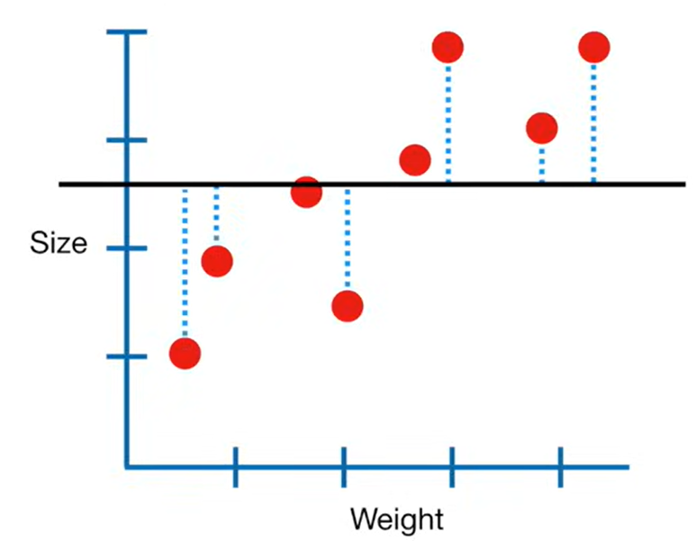
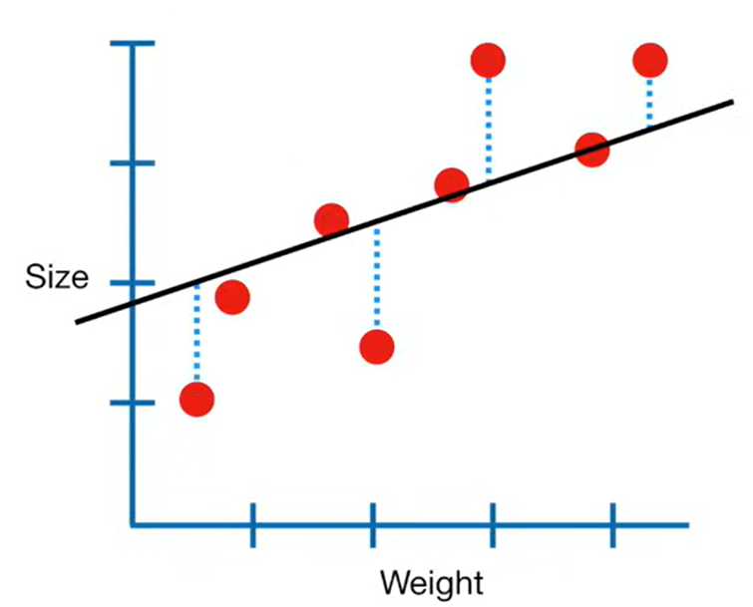
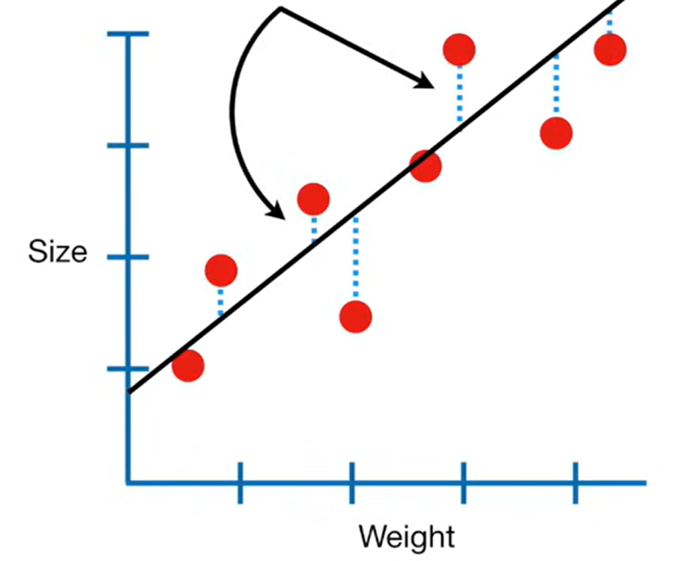
L2 Regularization: Example
So we will fit a line to the data using Least Squares. Ultimately, we find a line which result in the minimum sum of squared error.

Slide 20
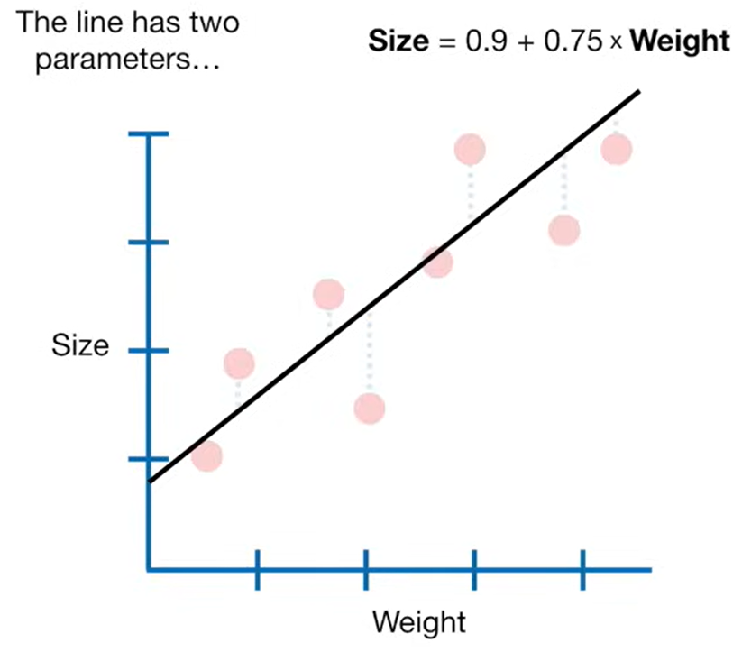
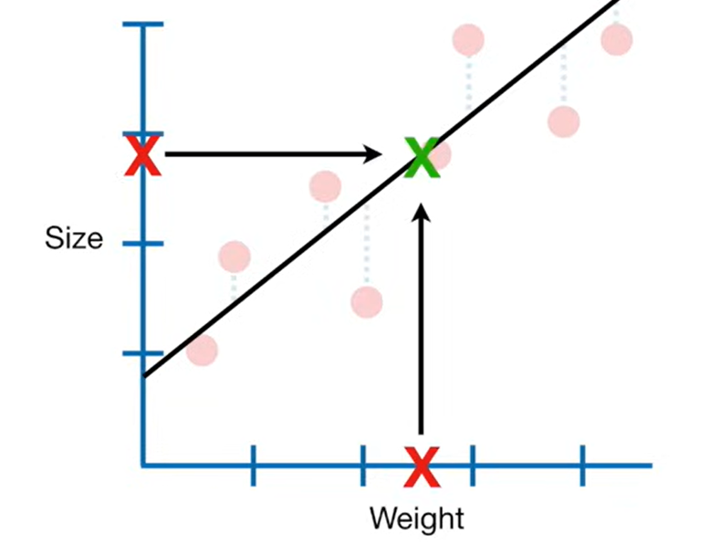
L2 Regularization: Example
Lets say, we get m = 0.75 and c=0.9
Plugging in the value of unseen weight, we can get the value of size.

Slide 21
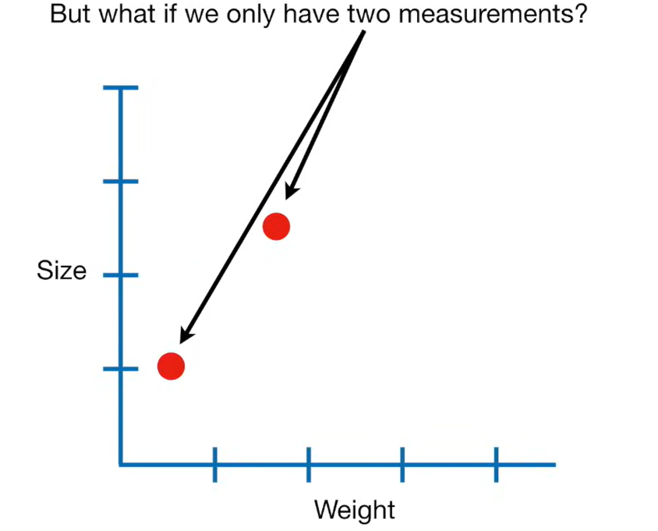
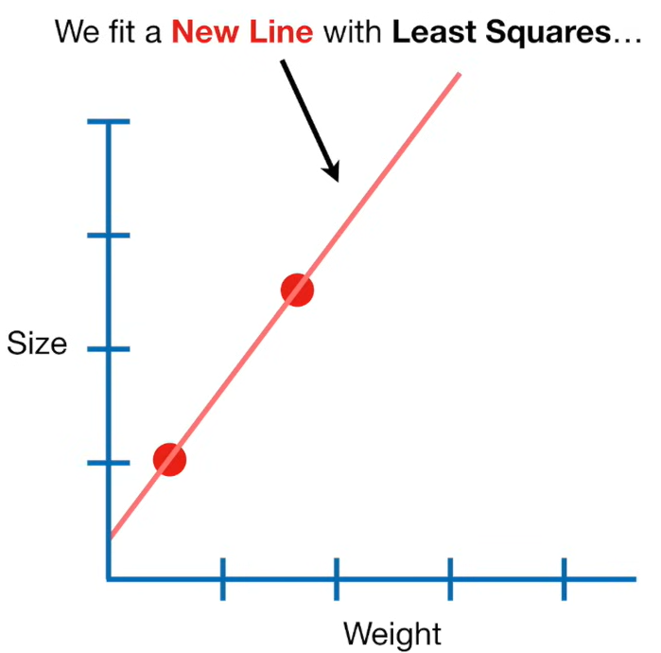
L2 Regularization: Example

Slide 22
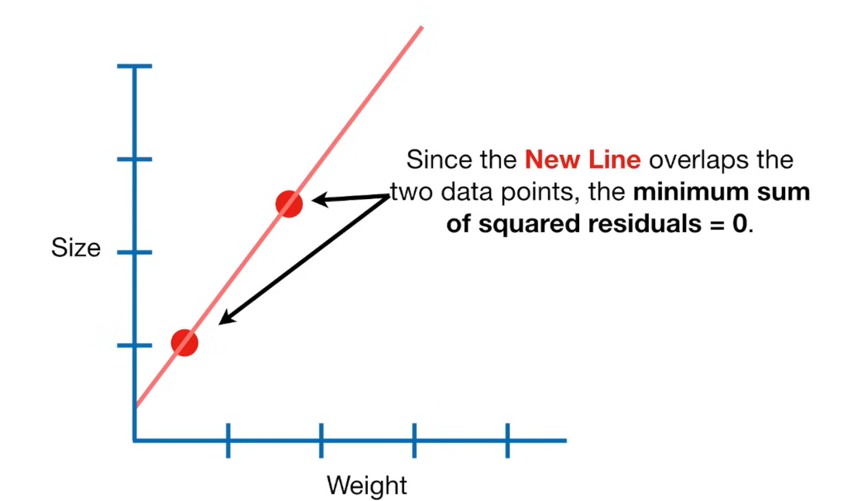
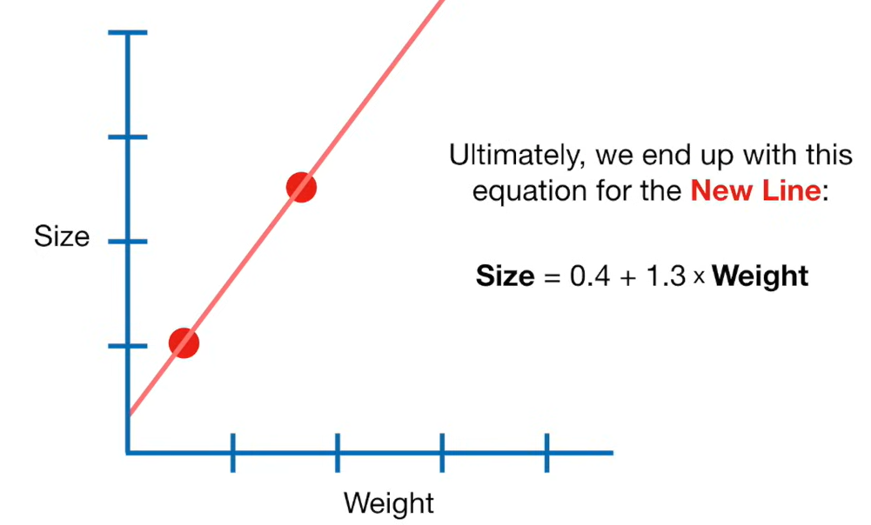
L2 Regularization: Example

Slide 23
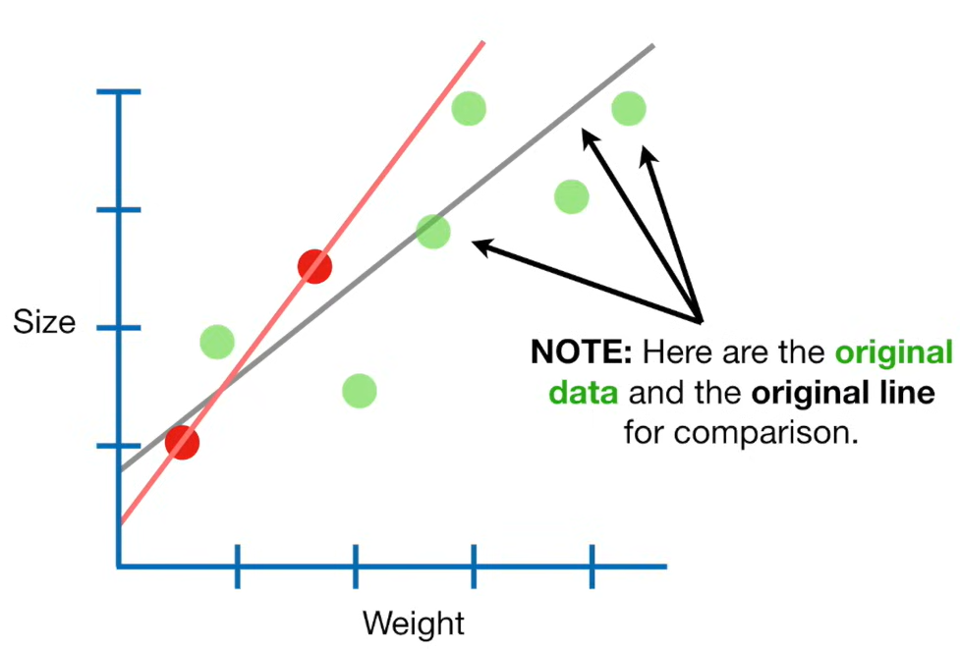
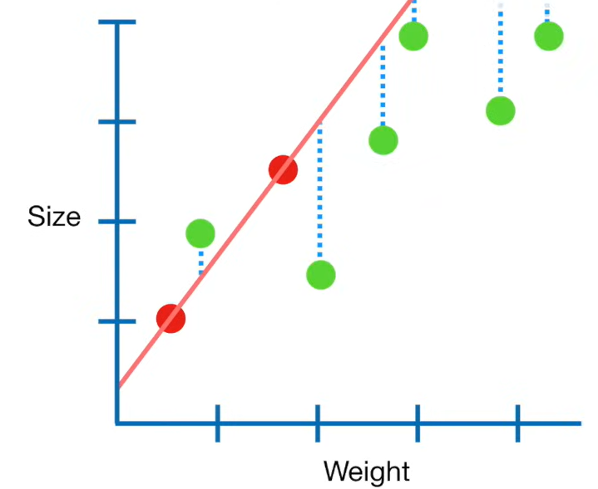
L2 Regularization: Example
Lets say red dots are training data, while the remaining green dots are test data
The sum of squared residuals (errors) for training data is 0 in this case. But SSE for green points (test data) is large.

Slide 24
L2 Regularization: Example
So, this new line has high variance.
In ML, we say this line over fit the training data

Slide 25
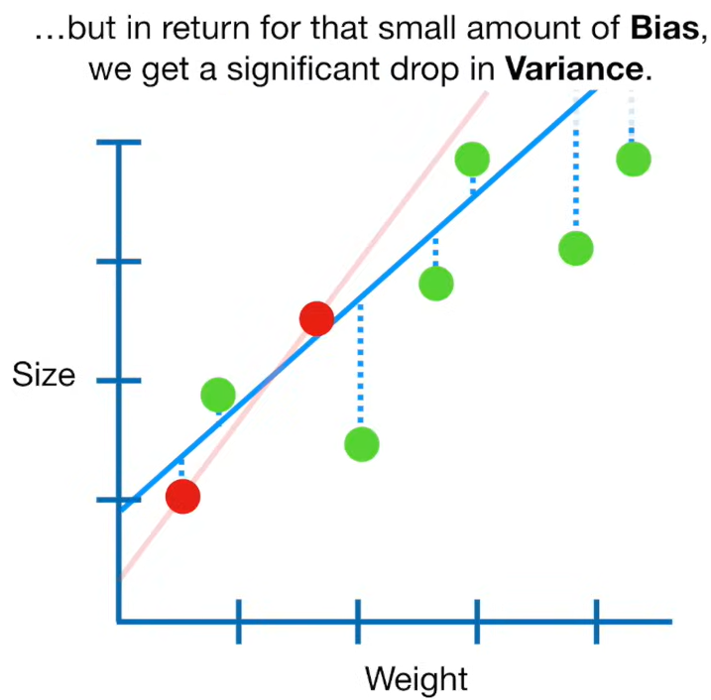
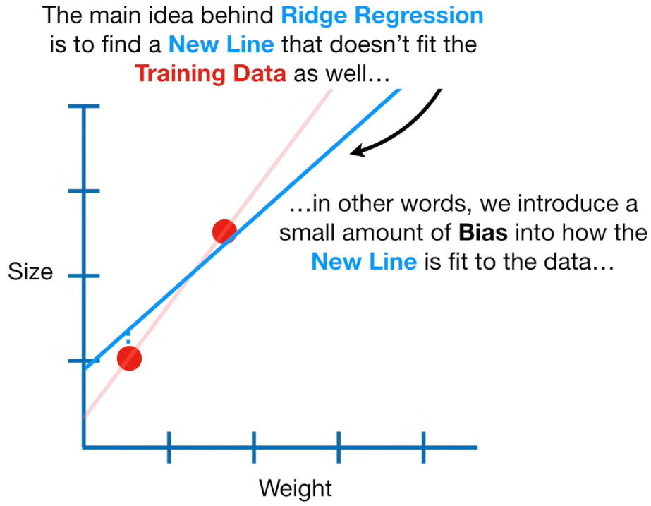
L2 Regularization: Example
So, starting with a slightly worse fit, Ridge regression can provide better long-term benefits.

Slide 26
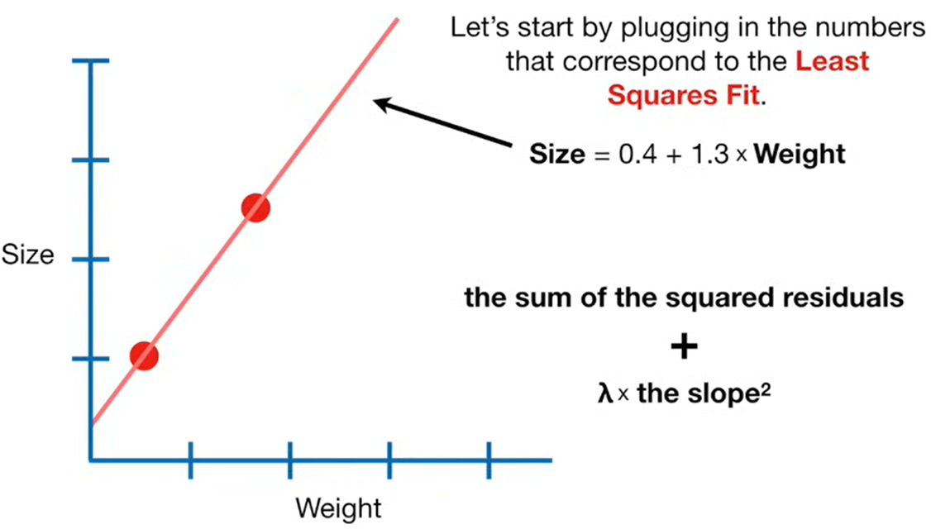
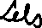
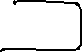
L2 Regularization: Example

Slide 27
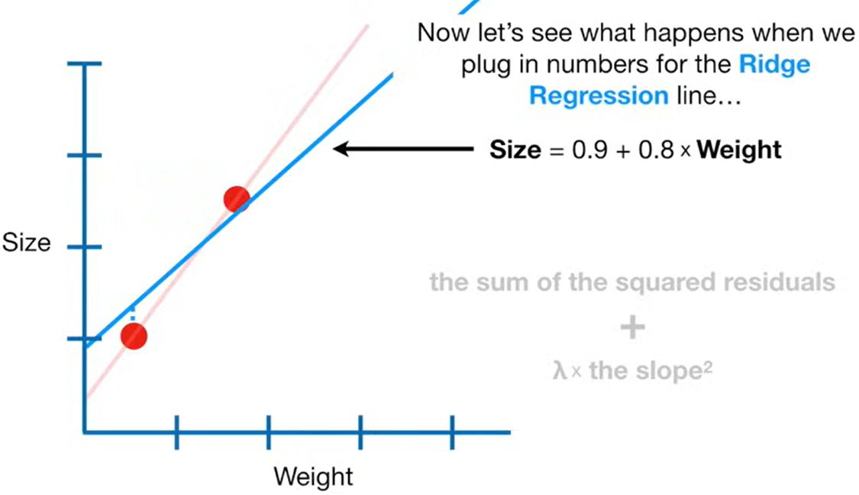
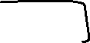
L2 Regularization: Example

Slide 28
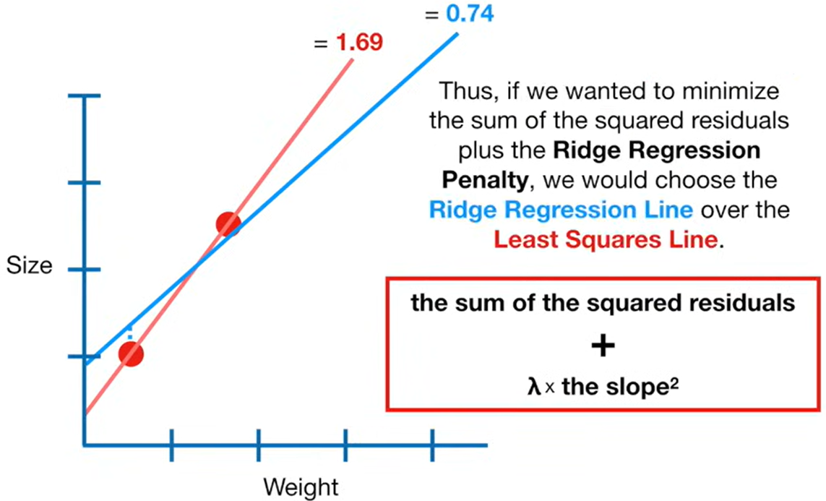
L2 Regularization: Example

Slide 29
Understanding Model fitting wrt bias and variance

Slide 30
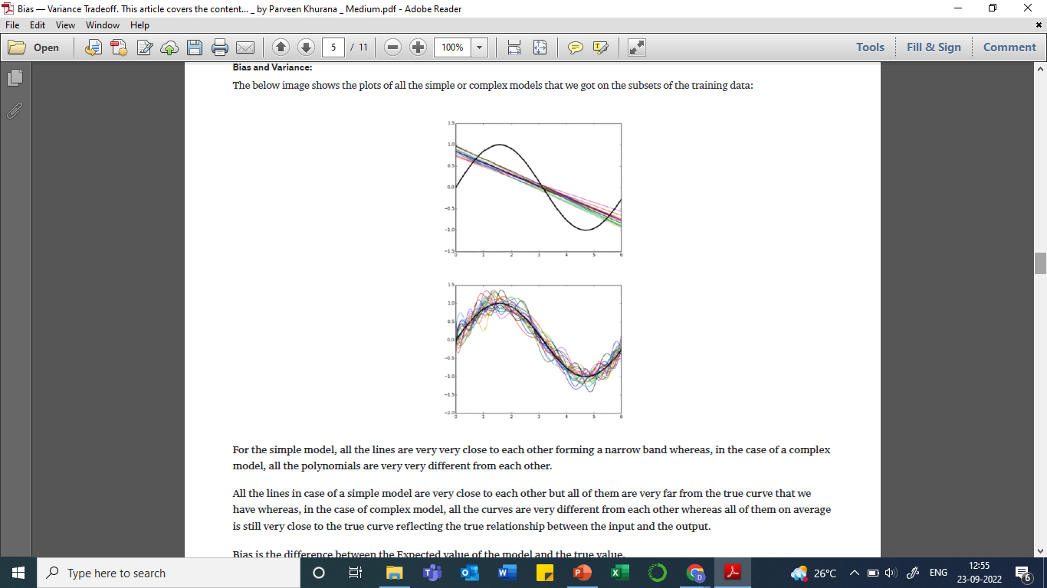
Bias
Bias is the difference between the average prediction of our model and the correct value that we are trying to predict.
Simple models trained on multiple subsets of training data.
Complex models trained on multiple subsets of training data.

Slide 31
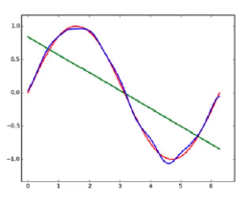
Bias
Bias is the difference between the average prediction of our model and the correct value that we are trying to predict.
Green line: Average prediction of simple models
Blue line: Average predictions of complex models
Red line: Actual curve of data points
Green line far from actual curve -> High bias
Blue line is close to the actual curve -> Low bias

Slide 32
Bias
Bias is the difference between the average prediction of our model and the correct value that we are trying to predict.
Model with high bias pays very little attention to the training data -> underfit model
Oversimplified model.
It always leads to a high error on training and test data.
Simple model = High bias = High training error

Slide 33
Variance
Variance is how our model prediction varies for a given data point
Average predictions of simple model will be close to the actual prediction of any one simple model, variance of the model is small.
Average predictions of complex models will not be close to the actual prediction of any one complex model, variance of the model is high.

Slide 34
Variance
Variance is how our model prediction varies for a given data point
Model with high variance pays a lot of attention to training data and does not generalize on the test data -> Overfit model
Such models perform very well on training data but have high error rates on test data.
Complex model = High variance = high test error

Slide 35
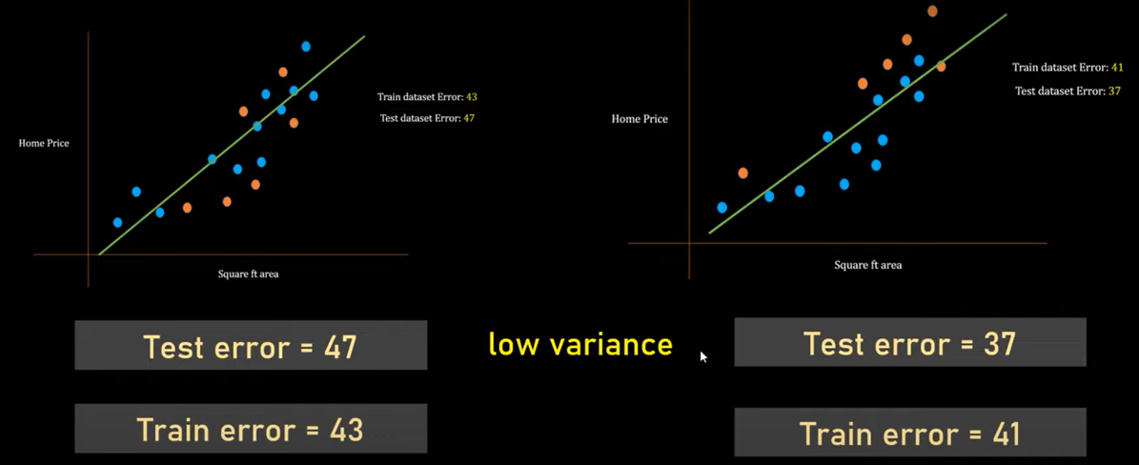
Example of underfitting and high bias

Slide 36
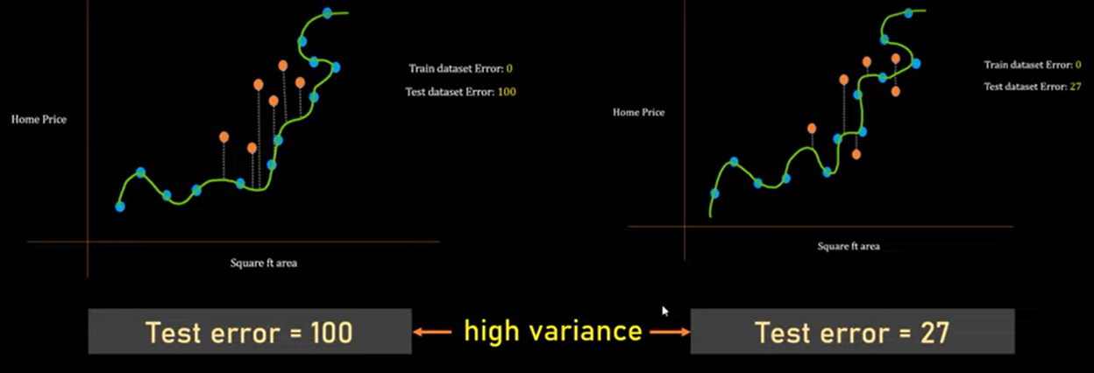
Example of overfitting and high variance

Slide 37
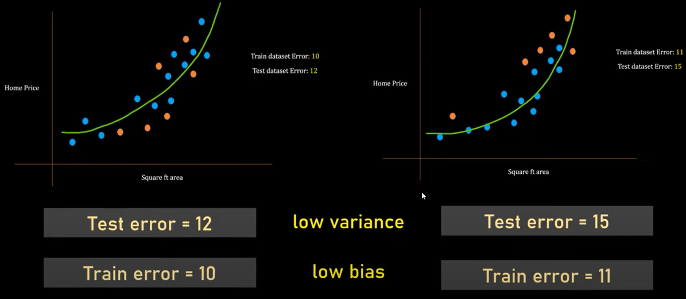
Example of balanced fit, low variance and low bias

Slide 38
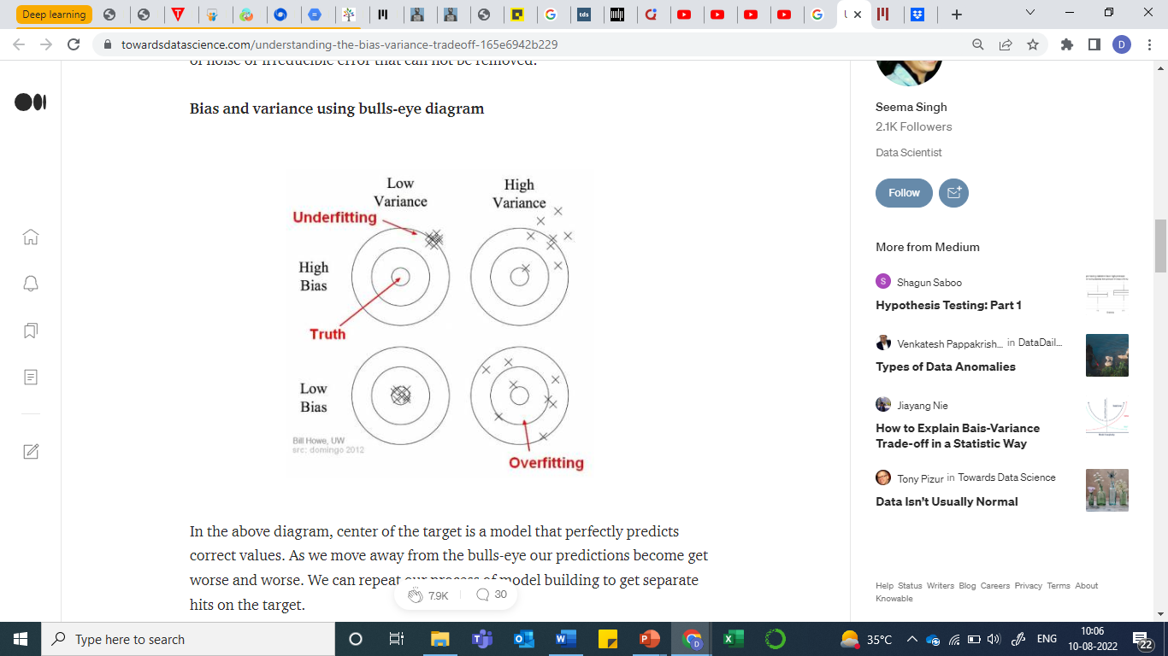
Bias-Variance Tradeoff using Bull’s eye diagram

Slide 39
Thank You

